Slide 1
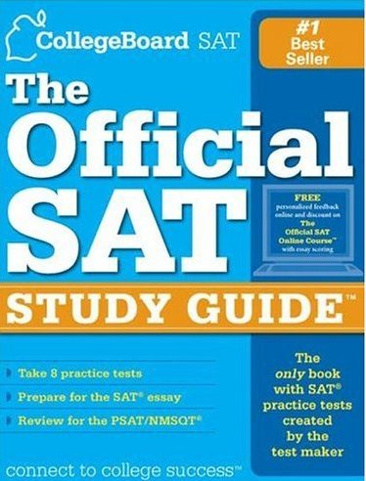
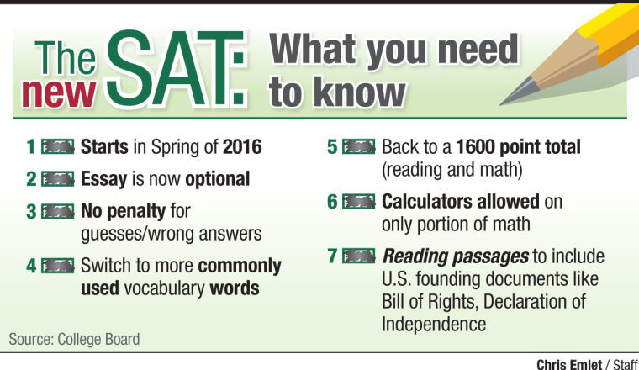
SAT Crash Course
What does the New SAT Do?
Assess students ability to apply their knowledge and skills
Demonstrate readiness for college and career success
Notes:
Emphasize that this is now a skills based test, no longer memorization and obscure information
Collegeboard book emphasizes that the best way to prepare for the test is to work hard in school
The SAT is designed to “reflect what you’re being taught in school, as well as the skills and knowledge you need to succeed in college and workforce training programs” but practice and familiarity with the test will help students improve their scores.

Slide 2
SAT Course Day 1 Activities
Tasks:
Get to know SAT Structure
What are the parts of the test?
How is each section structured?
What are some General tips for each Type of Test?
Tips for Test Taking
PSAT Test Book Scavenger Hunt
Tools to study with
Khan
PSAT Booklet

Slide 3
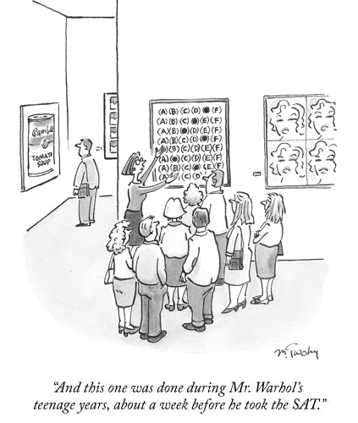
SAT Format
Emphasize that this is now a skills based test, no longer memorization and obscure information
The SAT is designed to “reflect what you’re being taught in school, as well as the skills and knowledge you need to succeed in college and workforce training programs” but practice and familiarity with the test will help students improve their scores
Test Organization
Total Time = 3 Hours
*4 separate tests
Reading = 65 minutes
Writing & Languages = 35 minutes
Short Breaks between

Slide 4
Parts of the Test
Reading
Writing & Language
.79 seconds Per Question!
65 minutes
52 total questions
5 passages:
Analyze and Use reasoning
Identifies students ability to evaluate
Command of evidence
Words in Context
Expression of Ideas
Topics:
Analysis in History/ Social Studies
Analysis in Science
Literature Passages
Passage Length = 500 – 750 words with a range of complexities
35 minutes
44 Total questions
4 passages:
Revise and Improve expression of ideas/ sentence mechanics
Topics:
A range of topics from arguments to nonfiction narratives about:
Careers, history/ social studies, the humanities and science. (1 a piece)
Passage length = 400 – 450 words with a range of complexities
1 minute 25 seconds Per Question
*it is important to keep in mind that you’ll spend time reading the four single passages along with one pair of passages.

Slide 5
Understand the Direction and Save Time!
Format
5 Passages total
1 of these will be a pair (2) of passages
Content of the questions
Reading Test
65 Minutes, 52 Questions
Turn to Section 1 of your answer sheet to answer the questions in this section.
Directions
Each passage or pair of passages below is followed by a number of questions. After reading each passage or pair, choose the best answer to each question based on what is stated or implied in the passage or passages and in any accompanying graphics (such as a table or graph).
Format
At least one of the passages will have a table/ graph

Slide 6
Understand the Direction and Save Time!
Format
Revise/ Edit – to improve and correct
Unique Answer Options
“No Change” if the sentence is correct
Writing and Language Test
35 Minutes, 44 Questions
Turn to Section 2 of your answer sheet to answer the questions in this section.____________
Each passage below is accompanied by a number of questions. For some questions, you will consider how the passage might be revised to improve the expression of ideas. For other questions, you will consider how the passage might be edited to correct errors in sentence structure, usage, or punctuation. A passage or a question may be accompanied by one or more graphics (such as a table or graph) that you will consider as you make revising and editing decisions.
Some questions will direct you to an underlined portion of a passage. Other questions will direct you to a location in a passage or ask you to think about the passage as a whole.
After reading each passage, choose the answer to each question that most effectively improves the quality of writing in the passage or that makes the passage conform to the conventions of standard written English. Many questions include a “NO CHANGE” option. Choose that option if you think the best choice is to leave the relevant portion of the passage as it is.

Slide 7
General Pointers
Key Section Strategies
Natural Order?
You’ll find questions about the passage as a whole — questions about the main idea or point of view, for example — early on in each set.
Questions about specific parts of the passage come later.
Questions about graphics and questions linking paired passages typically come near the end of the sequence.
Understand the ‘Natural Order’ of Reading Passage Questions
Don’t fall for the Challenging wording
Active Reading – Take Notes as you read!
Time Management

Slide 8
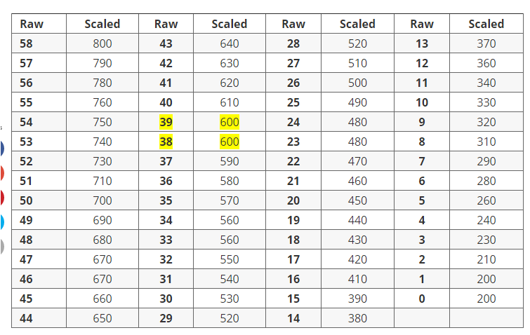
Math Section
Math Section Format
Two math sections (80 minutes - 58 questions.)
3 – 25 minutes with 20 questions non-calculator
4 – 55 minutes with 38 questions with a calculator
Multiple
Choice
Grid-In
Level of
Difficulty
Question arrangement:
Questions are arranged from easy to hard, by type.
For example if 1-5 are multiple choice and 6-10 are
grid in, then questions 1 and 6 are easy and 5 and 10 are hard.
1 2 3 4 5 6 7 8 9 10
Question Number
Question types:
45 multiple choice questions - 78%
13 grid-in questions - 22%
Set a goal for yourself and
determine where you are on
the pacing chart.

Slide 9
Math Section
Four Major Areas of Math
Content Area | Topics Covered | Calculator Questions | No-Calculator Questions
Heart of Algebra | Fundamental concepts in algebra involving linear equations and inequalities | 11 | 8
Problem Solving and Data Analysis | Interpreting qualitative and quantitative data, analyzing relationships | 17 | 0
Passport to Advanced Math | More advanced concepts in algebra, including quadratic and higher-order equations | 7 | 9
Additional Topics in Math | Geometry, trigonometry, complex numbers | 3 | 3
Data Analysis/Problem Solving
Algebra
Geometry
Trig
Notes:
Do half of the test

Slide 10
Specific Topics For Math Sections
Heart of Algebra topics: Linear Equations and Inequalities, Linear Modeling, System of Equations and Inequalities, Linear Interpretation
Problem Solving and Data Analysis: Ratios, Rates Proportions, Scales, Percents, Measurements, Scatterplots, Investigating Graphs, Linear vs Exponential Graphs, Two Way Tables
Passport to Advanced Math: Quadratics or Exponential Modeling, Forms of Expressions, Solving Quadratic Equations, Solving Radicals and Rationals, Rewriting Rationals, Polynomial zeros or factors, Nonlinear relationships, Function Notation
Additional Topics in Math: Complex Numbers, Circle Theorems, Congruence and Similarity Theorems, Trigonometric Ratios and Theorems

Slide 11
Math
Section
Calculators
Permitted Calculators
Unacceptable Calculators
Graphing calculators
Scientific calculators
Four-function calculators (not recommended)
Large calculator or raised buttons = sitting in a different area
Don’t have to clear memory
Laptop or a portable /
handheld computer
Calculator that has QWERTY (typewriter-like) keypad, uses an electrical outlet, makes noise, or
has a paper tape
Electronic writing pad or pen-input/stylus-driven device
Pocket organizer
Cell phone calculator
Tips:
Be Familiar with it
Check every number on the display as you key it in
Every question on the SAT can be answered without a calculator; sometimes faster
Clear between problems
Bring extra batteries

Slide 12
Math
Section
Grid-In Hints & Tips
After you get
the answer...
Answer = or 0.583
1
Determine how you will
write your answer
Fraction or decimal?
(either is ok)
7/12 or .583
2
Write answer
In this box
/
Check to see that your answer will fit in the box.
If negative or > 9999...
... its wrong.
-2.5
12,260
7
1
2
No credit for this
Helps avoid mistakes
Decimals can be truncated but use entire box
.666 not .67
Fractions do not need to be reduced unless they won’t fit in the box
8/16
12/16 3/4 .75
3
Grid in
Result
Be sure of answer before you grid, to avoid erasure marks
Fill in completely
Write mixed number as improper fraction
1 3/8 11/8
Don’t leave a grid question blank. Remember no points are taken off for wrong answers.

Slide 13
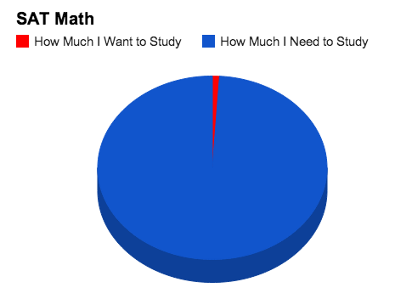
Practice makes…
SAT is an Achievement Test Not an aptitude test. You can improve your scores by practicing!
Studying is worth it!!!
How should you study?
Develop the knowledge & skills measured on the test
Many School related skills…
Familiarize yourself with the test
Study Tips:
Set aside time to study
Study with friends or by yourself but set a schedule with specific goals and
JUST DO IT!
Use Khan or a practice test to determine your strengths and weaknesses

Slide 14
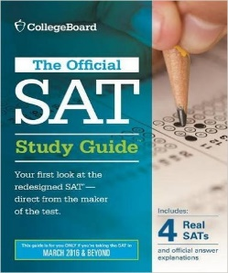
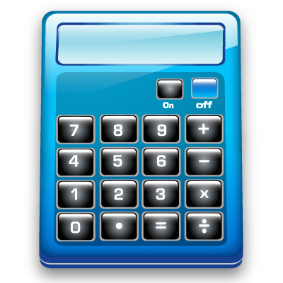
Practice Tools
PSAT Booklet
Khan
Scavenger Hunt
What is it?
How do I use it?
Why is it useful?
Practice Tests on Ivy Global
https://www.khanacademy.org/
http://sat.ivyglobal.com/new-sat-practice/

Slide 15
Scoring
How is your Test Scored?
Sections of the SAT
Significant for College Admittance
Total Score range = 400 to 1600
Evidence Based Reading & Writing
200 to 800
Math
200 to 800
Test Scores
Reading Test
Writing & Language Tests
Math Test
*10 – 40 converted to a scaled score
Subscores
Command of Evidence
Words in Context
Expression of Ideas
Standard English Conventions
Heart of Algebra
Problem Solving and Data Analysis
Passport to Advanced Math
*1 to 15 scale on various questions
Percentiles
Percentile by State and on the total group of test takers.
1 – 99 indicates the % of test takes who attained a score equal to or lower than yours.
4 Tests
Reading
Writing and Language
Math with Calculator
Math without Calculator
Optional Essay
Neither required nor recommended for many colleges (including UCONN)
Check online
Useful to know for studying if you are retaking the test

