Slide 1
Argumentative Writing!
Agenda:
Content Overview
Quick review of argumentative writing steps
Writing Self Assessment/ Goals
Source analysis
*Persuasion = a process aimed at changing a person’s (or a group’s) attitude or behavior toward some event, idea or object, by using written words to convey information, feelings or reasoning
*persuading someone to do or believe something through the use of reasoning
The Purpose of a persuasive essay is to test your ability to use your knowledge and writing ability to Persuade the reader on a particular topic…

Slide 2
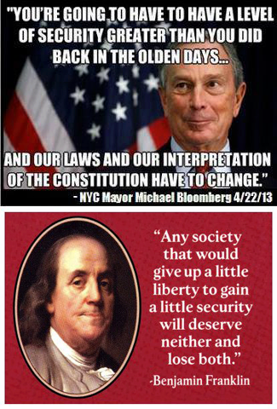
Content Overview
Liberty
Security
VS.
Liberty vs. Security
The state of being free within society from oppressive restrictions
The power or scope to act as one pleases
The preservation of extensive civil liberties
The state of being free from danger or threat
Procedures followed or measures taken to ensure the safety of a state or organization

Slide 3

What has happened to Civil Liberties historically during times of Crisis?
Examples of Crisis
Restrictions
The Civil War
WW1
First Red Scare
WW2
Second Red Scare
Habeas Corpus Suspended
Espionage & Sedition Acts
Palmer Raids
Japanese Internment
McCarthyism
The Supreme Court’s Role with the Constitution
What decides where the line between security and Liberty is drawn?
Schenck v. US 1919 – In a time of ‘Clear & Present Danger’ civil liberties can be restricted, especially in public spaces
New York Times Co. v. US 1971 – freedom of the press must be preserved as a check against gov’t power (classified Pentagon Papers on the Vietnam war were printed)

Slide 4
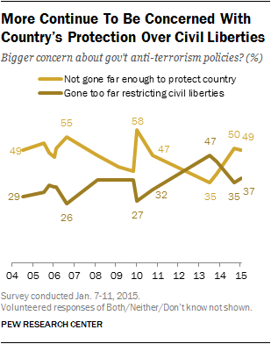

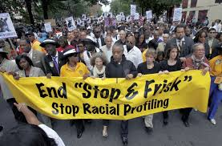

Current Events & Security Post 9/11
Examples:
Mayor Says New York City Will Settle Suits on Stop-and-Frisk Tactics

Slide 5


(USA PATRIOT) that stands for "Uniting and Strengthening America by Providing Appropriate Tools Required to Intercept and Obstruct Terrorism Act of 2001
Authorization of indefinite detentions of immigrants;
The permission given law enforcement officers to search a home or business without the owner's or the occupant's consent or knowledge;
The expanded use of National Security Letters, which allows the FBI to search telephone, e-mail, and financial records without a court order
The expanded access of law enforcement agencies to business records, including library and financial records.
Authorize court-approved roving wiretaps that permit surveillance on multiple phones.
Allow court-approved seizure of records and property in anti-terrorism operations.
Permit surveillance against a so-called lone wolf, a non-U.S. citizen engaged in terrorism who may not be part of a recognized terrorist group
Update on Patriot Act
Following a lack of Congressional approval, parts of the Patriot Act expired on June 1, 2015. With the passage of the USA Freedom Act on June 2, 2015 the expired parts were restored and renewed through 2019.
However, Section 215 of the law was amended to stop the National Security Agency from continuing its mass phone data collection program
…. Instead, phone companies will retain the data and the NSA can obtain information about targeted individuals with permission from a federal court (#Warrants)

Slide 6
Essay Topic
Should the federal government have the ability to restrict the rights of American citizens in a time of crisis?
We all like to think that Bill of Rights applies to all American citizens under any situation. We promote these civil liberties through our work and our personal interests every day. However, in times of crisis the response by the federal government has often been to promote the security of the nation while enacting legislation that temporarily suspends the Bill of Rights. These actions have long been debated by scholars and citizens who passionately support those who seek to reprimand the government for its restrictive behavior or support the government’s attempts to promote national security.

Slide 7

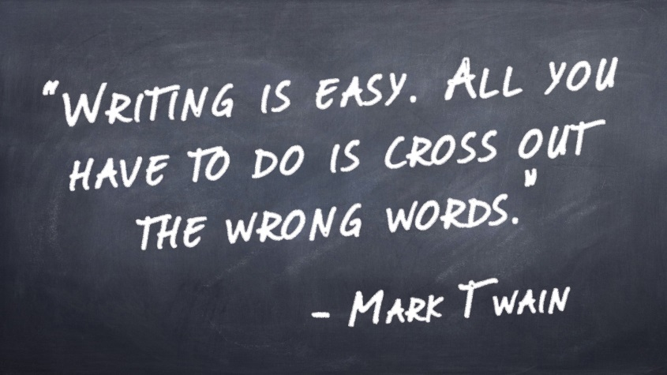

2. Quick review of argumentative writing steps

Slide 8
Steps to a Well Written Persuasive Paper
Read the question
  Determine what the assignment is asking you to do. What is the question asking you to decide?
Read through and analyze the sources
  DO NOT SKIP THIS STEP
Outline and organize your paper
Write!
Revise and edit

Slide 9
Read and Understand the Question
Should the federal government have the ability to restrict the rights of American citizens in a time of crisis?
_________________ vs. _________________
Based on the question and task page what is the question asking YOU to decide?
What is the scenario? (who is the audience and what is the purpose of your argumentative essay?)

Slide 10
2. Read through and analyze the sources
Steps to Active Reading:
  1. Gain an overview of the text before reading
  2. Read with purpose
  3. Understand Vocabulary
  4. Make Connections so that you remember what you read
  5. Keep Track of your reading
    Take notes, highlight, track the words with your pencil

Slide 11
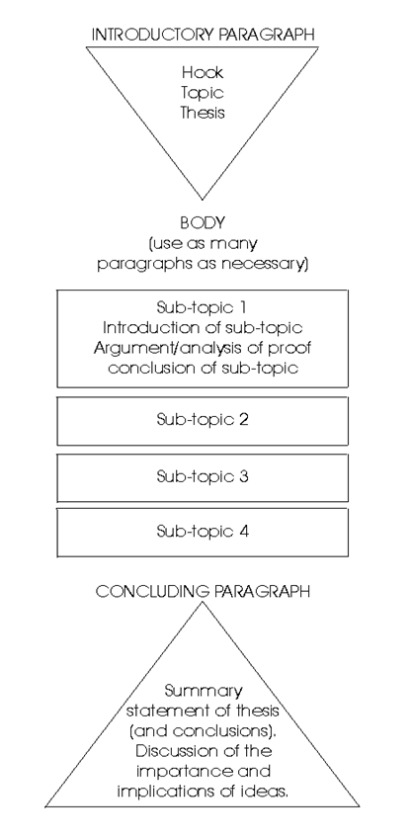
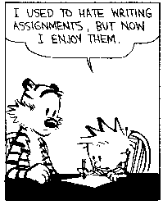
3. Outline and organize your paper
Hone your outline and then cling to it as a lifeline. You can adjust it in mid-stream, but don’t try to just write your way into a better structure: think about the right structure and then write to it. Your outline will get you through those periods when you can’t possibly imagine ever finishing the thing — at those times, your outline will let you see it as a sequence of manageable 1,000 word sections.
Plan it out!
- Bill Wasik
Author of And Then There’s This: How Stories Live and Die in Viral Culture

Slide 12
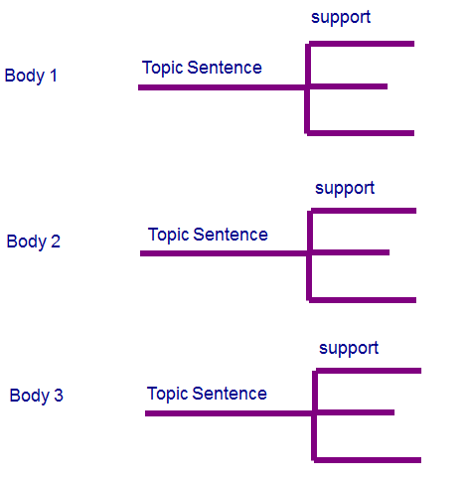
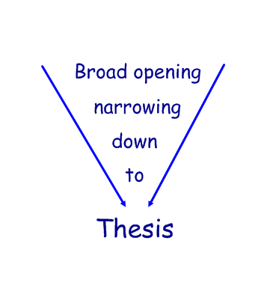
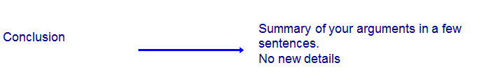
Introduction
Body Paragraphs
Without a Thesis
With a Thesis

Slide 13
Parts of a Body Paragraph
Topic Sentence –
  Position + Argument
Tag, “Supporting Detail/ Evidence,” (citation).
Analysis and Explanation
Tag, “Supporting Detail/ Evidence,” (citation).
Analysis and Explanation
Tag, “Supporting Detail/ Evidence,” (citation).
Analysis and Explanation
Transition/ Conclusion

Slide 14
The Spartan polis was superior to other Greek city-states because Spartan women had roles outside of the traditional Greek home sphere that gave them more independence and duties. These features required them to be in good physical shape, have the ability to inherit property, and have an education beyond the Athenian housewife’s skills. According to Xenophon, the Spartans “arranged competitions of racing and strength for women also, thinking that if both parents were strong their children would be most robust,” while “other Greeks expect girls to sit quietly and work wool,” (Doc 4). This difference in social expectations highlights how Spartan women were encouraged to be different from other Greek women. The public competitions allowed Spartan women to fulfill their obligation to have strong children but it also allowed them to compete in tasks that were restricted to men in other Greek poli. Rather than confining them to a more traditional and one dimensional occupation, such as weaving wool, Spartan women were given tasks and responsibilities that were of equal importance for the wellbeing of the community and were trained accordingly. Aristotle also demonstrated the importance the women’s role in Sparta when he stated that “nearly two-fifths of the whole country is in the hands of women” because they were allowed to inherit property, (Doc 4). While Aristotle, like a traditional Greek male, disapproved of the practice of letting women inherit, the Spartans clearly embraced this practice. By giving women the right to inherit property Sparta allowed them a more active role in the community and clearly tied them to the wellbeing of the Polis in a more literal way, by expecting them to more deeply care for the property that was legally theirs. In addition to Spartan women having more freedom than other Greeks they were also given greater responsibility and according to historians Duiker and Spielvogel, “upheld the strict Spartan values, expecting their husbands and sons to be brave in war,” (Doc 1). All of the additional physical training and inheritance rights made the Spartan women more invested in their communities and as a result they felt the responsibility to uphold the Spartan militaristic values as keenly as any of the men. By encouraging their husbands and sons to participate bravely in war they demonstrated their patriotism and commitment by sacrificing their own personal happiness for the good of the greater community. Spartan women had more freedoms and responsibilities than the other Greek communities and as a result Sparta also had a stronger community culture that made them a superior polis.
[The Spartan polis was superior to other Greek city-states] because Spartan women had roles outside of the traditional Greek home sphere that gave them more independence and duties.
Spartan women had more freedoms and responsibilities than the other Greek communities and as a result Sparta also had a stronger community culture that made them a superior polis.

Slide 15
[The Spartan polis was superior to other Greek city-states] because Spartan women had roles outside of the traditional Greek home sphere that gave them more independence and duties. These features required them to be in good physical shape, have the ability to inherit property, and have an education beyond the Athenian housewife’s skills. According to Xenophon, the Spartans “arranged competitions of racing and strength for women also, thinking that if both parents were strong their children would be most robust,” while “other Greeks expect girls to sit quietly and work wool,” (Doc 4). This difference in social expectations highlights how Spartan women were encouraged to be different from other Greek women. The public competitions allowed Spartan women to fulfill their obligation to have strong children but it also allowed them to compete in tasks that were restricted to men in other Greek poli. Rather than confining them to a more traditional and one dimensional occupation, such as weaving wool, Spartan women were given tasks and responsibilities that were of equal importance for the wellbeing of the community and were trained accordingly. Aristotle also demonstrated the importance the women’s role in Sparta when he stated that “nearly two-fifths of the whole country is in the hands of women” because they were allowed to inherit property, (Doc 4). While Aristotle, like a traditional Greek male, disapproved of the practice of letting women inherit, the Spartans clearly embraced this practice. By giving women the right to inherit property Sparta allowed them a more active role in the community and clearly tied them to the wellbeing of the Polis in a more literal way, by expecting them to more deeply care for the property that was legally theirs. In addition to Spartan women having more freedom than other Greeks they were also given greater responsibility and according to historians Duiker and Spielvogel, “upheld the strict Spartan values, expecting their husbands and sons to be brave in war,” (Doc 1). All of the additional physical training and inheritance rights made the Spartan women more invested in their communities and as a result they felt the responsibility to uphold the Spartan militaristic values as keenly as any of the men. By encouraging their husbands and sons to participate bravely in war they demonstrated their patriotism and commitment by sacrificing their own personal happiness for the good of the greater community. Spartan women had more freedoms and responsibilities than the other Greek communities and as a result Sparta also had a stronger community culture that made them a superior polis.

Slide 16
4. Write!
Major Issues for Junior Writers
  Remember to use Formal writing/ language
    You are trying to sway National opinion & change the future … using slang, colloquialisms or just poor language & sentence structure will not help you do this
  Topic Sentence
    This has become very formulaic (if included at all)
      Examples:
        First of all…
        To start with …
        Initially …. (you’re not using initially correctly…)

Slide 17
4. Write!
Major Issues for Junior Writers
  Using supporting Evidence
    Do not make unsupported and vague arguments
    Beware listing… make sure your include an explanation of how the information connects to your argument
    CITE YOUR SOURCES
  Transitions
    There are 2 types of Transitions
      Transitional phrases/ words within a body paragraph that contribute the fluency and form of the paragraph.
      The transitions between paragraphs that focus on transitioning the reader from one argument to the next.

Slide 18
Transitional Phrases occur WITHIN a Paragraph
I don’t wish to deny that the flattened, minuscule head of the large-bodied "stegosaurus" houses little brain from our subjective, top-heavy perspective, BUT I do wish to assert that we should not expect more of the beast. FIRST OF ALL, large animals have relatively smaller brains than related, small animals. The correlation of brain size with body size among kindred animals (all reptiles, all mammals, FOR EXAMPLE) is remarkably regular. AS we move from small to large animals, from mice to elephants or small lizards to Komodo dragons, brain size increases, BUT not so fast as body size. IN OTHER WORDS, bodies grow faster than brains, AND large animals have low ratios of brain weight to body weight. IN FACT, brains grow only about two-thirds as fast as bodies. SINCE we have no reason to believe that large animals are consistently stupider than their smaller relatives, we must conclude that large animals require relatively less brain to do as well as smaller animals. IF we do not recognize this relationship, we are likely to underestimate the mental power of very large animals, dinosaurs in particular.
Stephen Jay Gould, “Were Dinosaurs Dumb?”

Slide 19
Transition Sentences
Changing Ideas – Smoothly
Transition between Ideas:
Example:
Paragraph 1 Conclusion/ Transition – While the Spartan men were excellent warriors who focused on protecting their homeland they also expected women to serve the community and gave them freedoms and responsibilities other Greek women were unaccustomed to. By giving men and women specific tasks to accomplish the community ensured that it would be both protected and well run in times of war.
Paragraph 2 Intro – The Spartan polis was superior to other Greek city-states because Spartan women had roles outside of the traditional Greek home sphere that gave them more independence and duties. These features required them to be in good physical shape, able to inherit property, and have an education beyond the Athenian housewife’s skills.
Activity
Read through the transitions of your essay
Rewrite one transition so that your two arguments flow from one to another
*try to avoid using transitional words just to use the words…

Slide 20
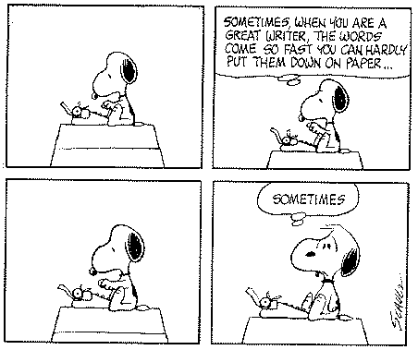
4. Write!
Writing means sharing. It’s part of the human condition to want to share things – thoughts, ideas, opinions.
- Paulo Coelho
Be aware of your strengths and weaknesses as a writer.
ASK QUESTIONS if you get stuck

Slide 21
Revise and Editing
Don’t look back until you’ve written an entire draft, just begin each day from the last sentence you wrote the preceding day. This prevents those cringing feelings, and means that you have a substantial body of work before you get down to the real work which is all in…
The edit.
Read through your essay and check for mistakes or to clarify
  Grammar and Spelling
    1. Check your spelling.
    2. Check your grammar.
    3. Make sure each sentence has a subject.
    4. Check the verb tenses of each sentence.
    5. Make sure that each sentence makes sense.
  Style and Organization
    1. Make sure your paragraph has a topic sentence.
    2. Make sure your supporting sentences focus on the main idea.
    3. Make sure you have a closing sentence.
    4. Check that all your sentences focus on the main idea.
    5. See if your paragraph is interesting.

Slide 22
3. Writing Self Assessment/ Goals
How did you do on Essay 1 ____, Essay 2 ____
What is your Grade goal for Essay 3 ________
What area are you strongest at in the writing process? ______________________________
What area do you require the most improvement in during the writing process? ________________________________________

Slide 23
4. Source Analysis
Identify:
Document:
Author:
Is the Author Reliable? Why or Why not? Main Idea Summary:
Active Reading!!!
  Gain an overview of the text before reading
  Read with Purpose
  Understand the Vocabulary
  Connect with what your reading
  **KEEP Track of your Reading ***
Arguments | Supporting Detail
A reason or set of reasons given with the aim of persuading others that an action or idea is right or wrong. | Specifics and details that support the arguments and provide useful information for the reader.
Conclusion on source: (How can you use this source in your paper? What position does this source support? Etc.)

